Slide 1
Network for connecting robots,
sensors, drones, unmanned surface
and underwater vehicles
in Oil & Gas Industry:
on the ground
in the air
on the water surface
underwater
2017

Slide 2
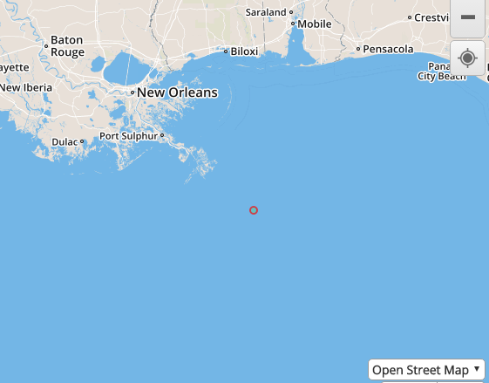
Wireless equipment and networks on the market have some serious disadvantages
All mobile networks on the market (3G, 4G, LTE, Wi-Fi, etc.) operate in UHF spectrum (frequencies above 430 MHz) and have some serious disadvantages:
short range: usually the radius of coverage of UHF transceivers is about 3 - 10 kilometers. As an example, a circle with 3 km radius in the gulf of Mexico.
totally unstable connectivity (especially in bad weather)
highly susceptible to hacking
do not allow successful integration of drones, autonomous surface vehicles, etc. for commercial operations

Slide 3
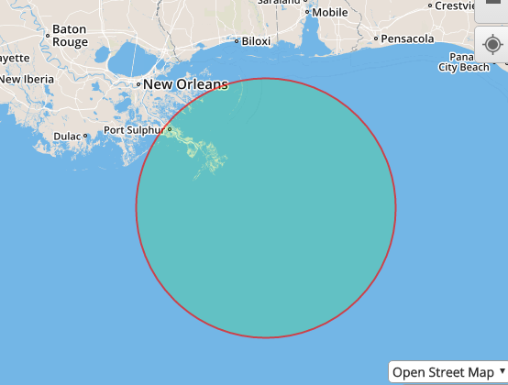
With new technologies networks can be drastically improved
Next generation antenna technologies allow creating mobile mesh-networks on HF & VHF frequencies with long range up to 150 km communications and additional encryption on hardware level
Next generation antenna technologies can drastically improve wireless networks, equipment and devices:
long range: allow adding HF & VHF spectrum for mobile broadband in order to bring long range communications up to 150 kilometers from transceiver
100 % stable connectivity in any weather (even in storm)
Cybersecurity: construction of networks with additional encryption on hardware level, using frequency hopping in a very wide range.

Slide 4
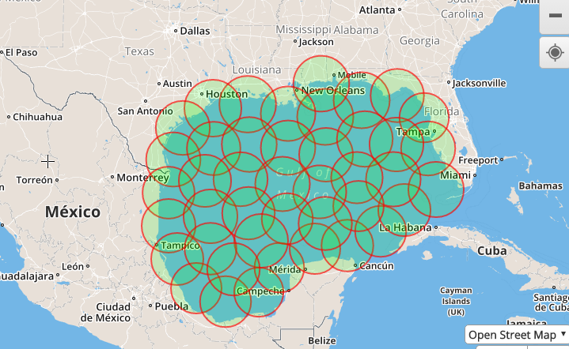
Covering large areas with 100% stable, highly secure and cheap connectivity
As an example, even 30 transceivers with next generation antenna systems, installed on ships, buoys, platforms, etc. can cover the whole area of Gulf of Mexico with highly secure, stable, high speed (23 Mbps) mobile connectivity which will be very cheap:
at least 200 times cheaper in comparison with mobile networks on the market
at least 1000 times cheaper in comparison with satellite communication networks on the market

Slide 5
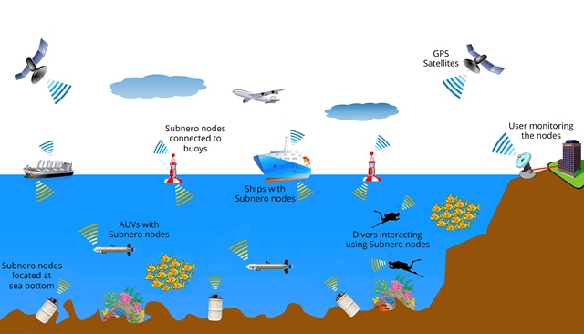
One single highly secure mesh-network to connect and operate objects on the ground, in the air,
Using these highly secure mobile data links it is possible to connect all sensors robots, sensors, drones, unmanned surface vehicles for various commercial operations
Underwater acoustic, optical and wired connections can be combined in one single mesh-network

Slide 6
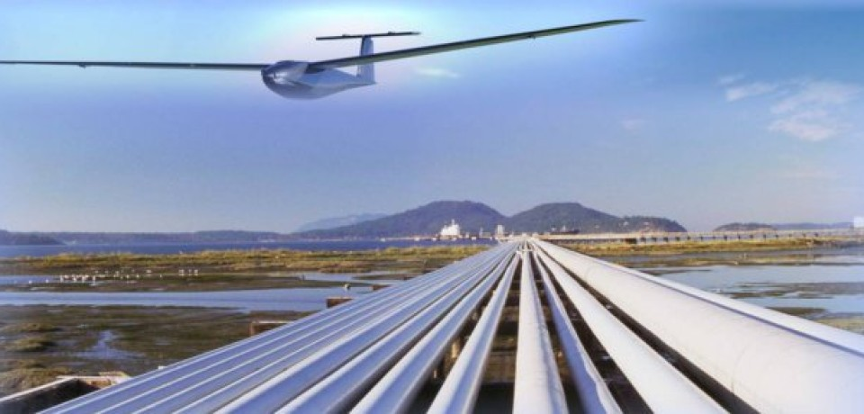
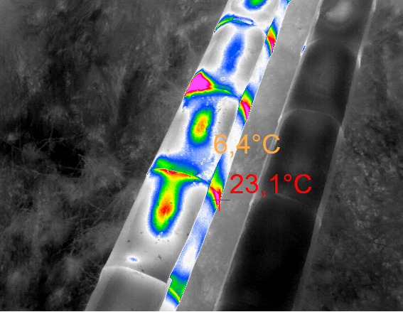
Pipeline monitoring and data gathering from sky using network of drones
Drastically decrease OPEX & CAPEX on pipeline monitoring and data gathering 24/7
10x times cheaper in comparison with small aviation
Several times cheaper in comparison with current drone technologies on the market , because of the ability to operate network of drones from any distance (right now maximum distance on the market is 50 km for each drone)

Slide 7
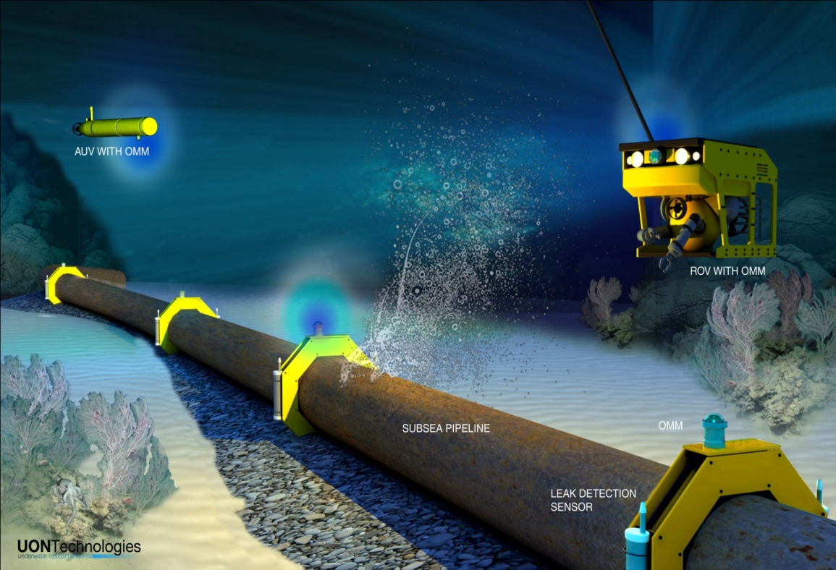
Underwater monitoring and leak detection
Integration of autonomous underwater vehicles
Drastically decrease OPEX & CAPEX on underwater pipeline monitoring

Slide 8
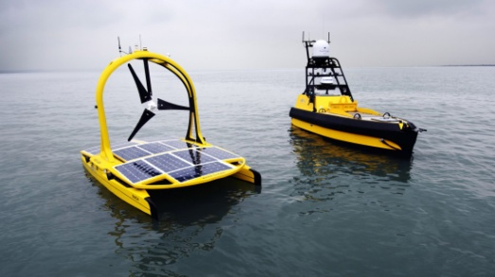
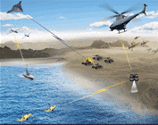
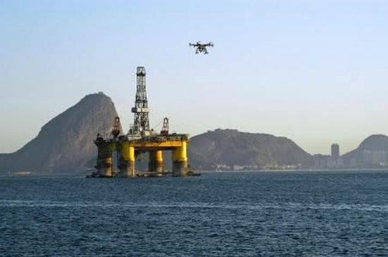
Connecting autonomous surface vehicles and drones for various commercial marine operations
Integration of autonomous underwater vehicles
Decrease OPEX & CAPEX for various marine operations and surveying
Interconnect drones on the water surface, on the land and in the sky in one single mesh-network

Slide 9
Pilot project cost
Estimate pilot project cost is $23 M

Slide 10
About us
Genesys Technologies LTD is a team of top specialists in the field of wireless communications, cybersecurity and unmanned systems.
During many we are closely working with:
FCC: Federal Communications Committee
FAA: Federal Aviation Administration
DARPA: Defense Advanced Research Projects Agency
DOD: Department of Defense
US Congress
UN project office on governance

